Slide 1
Book Catalogue XML Converter

Slide 2
INRTRODUCTION
Background - C# programming language - Information of books - 3 converters - 2 packages
Objectives - Convert XML to other compatible - Reduce complexity by converting XML data & creating data that are easy to read by any kind of application - Conduct analysis of data in other compatible formats - Automatic record of converted files

Slide 3
INRTRODUCTION - Cont.
Advantages - HTML * Better arrangement and visualization of info * Better readability * Browser processable
- EXCEL
* Statistical analysis
* Easy manipulation of data
- JSON
* More compact, more readable & faster transmission
* Easier for human beings to parse
* Easier to conduct analysis of data
- Automatic record of converted files

Slide 4
METHODOLOGY
Flowchart

Slide 5
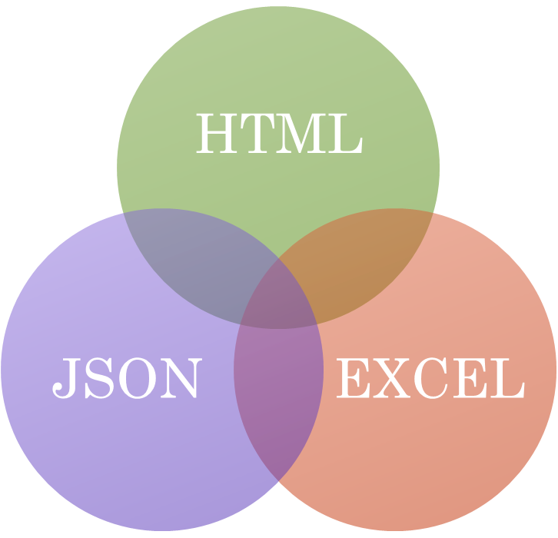
DEMONSTRATION

Slide 6
THE END

